Slide 1

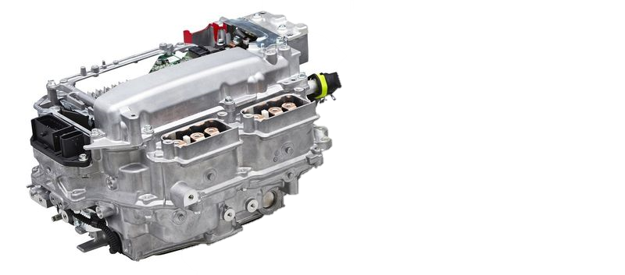

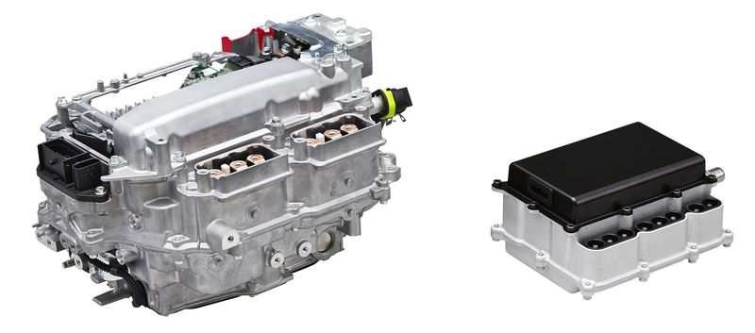

Internship Presentation Research & Modeling of Power Electronics applied to PHEVs or BEVs
04/10/2021 – 03/04/2022 Toyota Motor Europe – PT 2 – Advanced Powertrain Alexandros Anastasiou
Notes:
Hello, my name is Alexandros Anastasiou, I know most of you already. I am in advanced powertrain, and I started my internship in Toyota in October. The Topic of my internship, and this presentation’s, is going to be the Research & Modeling of Power Electronics applied to Plug In Hybrid and Battery EVs, electric vehicles.

Slide 2
PCU Research internship Schedule
TODAY
October |  |  | November |  |  | December |  |  | January |  |  | February |  |  | March
Research Mapping (IEEE Database)
Investigate methods / software
[Task 1]
Manual retrieval IEEE Databases
Database import to PowerBI
Power BI trainings
Established Power BI structure “template”
Data Classification & Analysis using Machine Learning
Automated database import, clean-up & publication
Results analysis
Dashboard publication
Topologies Mapping (OBC, Inverter, DC-DC)
[Task 2]
Onboard Charger topologies
DC/DC Converter topologies
Inverter topologies
PFC, extras & Results
Supporting Activities
[Task 3]
IEEE CPE PowerEng 2021 – Conference summary
Cable equivalent impedance model (Integrated Charger)
EMC Europe 2021 - Summary
Notes:
My internship completed 3 main tasks. 1. The first and eventually largest task was to map the Research of IEEE Database using novel methods and professional software for the first time. This was my main project starting from December.
2. The second task was to map the topologies of certain power electronics parts of EVs. Most attention was given in Onboard Chargers.
3. And my third and final task was to support in activities regarding conferences and the simulations of parts of power electronics.

Slide 3
1. Research Mapping
Contents:
Why to map Research & Classification Methods Used
How the mapping was done:
Classification 1: by most frequent words (Freq)
Classification 2: using Machine Learning (ML)
Comparison of Methods
Results, Conclusions
Manually Retrieve Data
Classify (1)
PowerBI Visuals
Interface
Affiliation
PowerBI Visuals
Classify (2)
Location
Notes:
So let’s dive into the first task, called Research Mapping.
First of all, I will explain WHY the mapping is needed, and what where the approaches I went with to do it.
Then I will explain HOW this was achieved. You will see afterwards that two methods were utilized, so there is a need for comparison, to see what works, how well it works and which option is better in the end.
And of course in the end some interesting results will be shown.

Slide 4
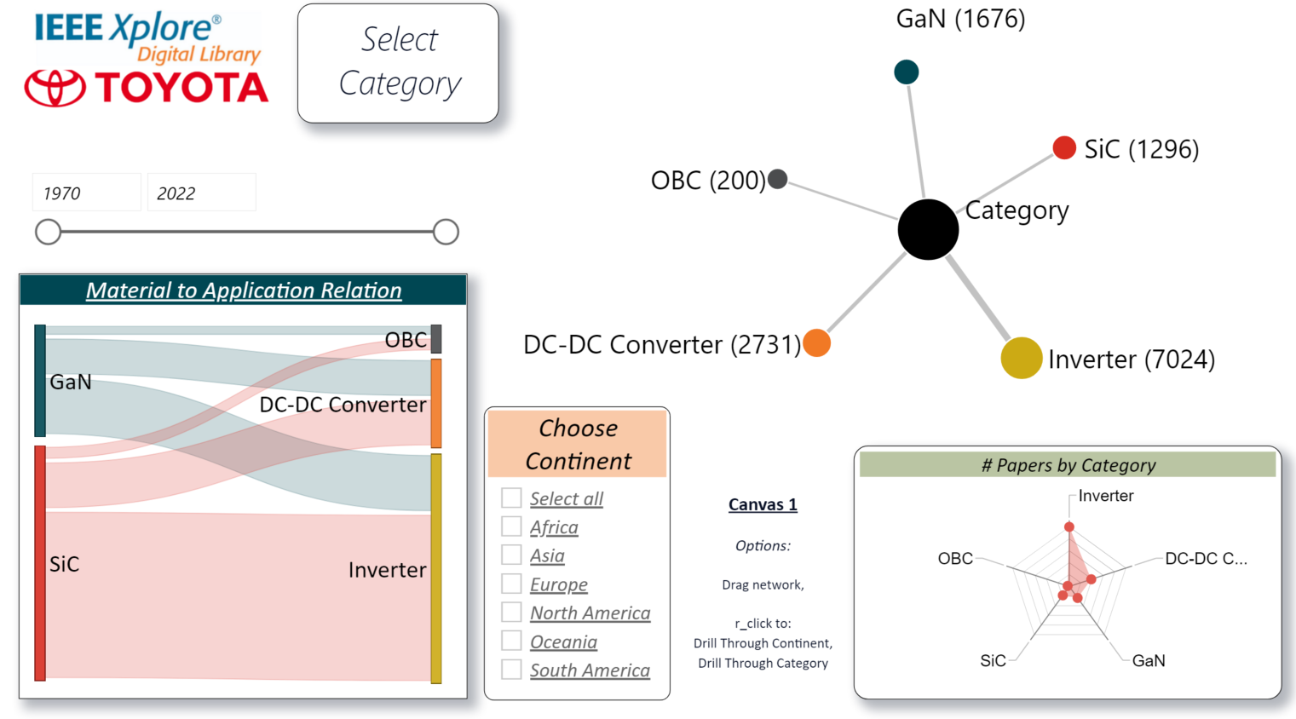
Why & How
Classification 1 - Freq
Classification 2 – ML
Comparison of Methods
Results
1. Research Mapping Why to map Research and Classification Methods Used
Method 1 :
CATEGORIES
Onboard Charger (OBC)
DC/DC Converter
Inverter
GaN Technology
SiC Technology
Method 2 :
Slow
Automatic Fast
Retrieve Data Manually
Most frequent word classifies the paper
Retrieve Data with Interface (API)
ML Algorithm used for Classification
RESULTS
VISUALS
Fast Not Flexible Not consistently
accurate
Slow Flexible Accurate
Goal: Understand Technology Trends
Process: 1. Download, 2. Extract, 3. Classify, 4. Visualize
Notes:
The goal of this task is to understand the technology trends.
There are 5 main categories of interest, which you will see through the whole presentation. These are the OBC, the DC/DC Converter, the Traction Inverter, and GaN or Gallium Nitride and SiC or Silicon Carbide switch device technology. Or in short, transistors.
YELLOW: As a first step, whichever model will be created, has to retrieve the data first.
The left column describes the first method used, in which we have to import the data manually, by hand, which is a slow process.
Then, the classification of the papers happens with a method that is very fast but not flexible and not consistently accurate, so in the end, this one was aborted,
But it can still prove useful in some cases we will shortly explain.
And now, on the right side you will see the method that was used in the end.
Here the papers from IEEE are imported with scripts, relatively quickly and without touching the process.
Then the papers are classified with a Machine Learning algorithm, making the solution sufficiently accurate and much more flexible,
So that it can be applied in different fields of interest, but at the same time the processing takes much more time.
Finally, the data is imported in PowerBI software, in order to visualize the results.

Slide 5
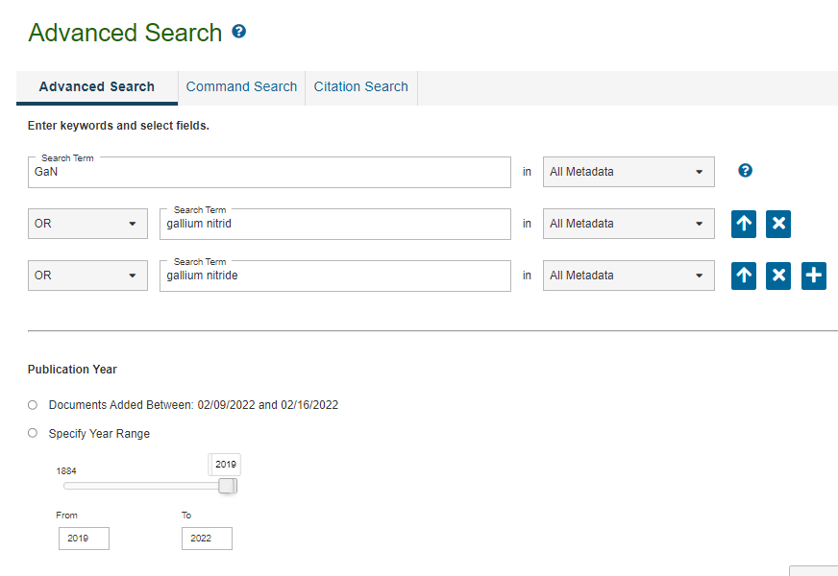

Why & How
Classification 1 - Freq
Classification 2 – ML
Comparison of Methods
Results
1. Research Mapping Classification 1: by most Frequent Words
1. Retrieve Data:
*Journals == Papers
IEEE Database: 5.6 million entities LIMIT: 2000 Papers / Download
2. Edit & Classify:
Python
Papers are classified based on certain, targeted keywords
Example: “An Analytical Scalable Lumped-Element Model for GaN on Si Inductors”
CATEGORIES
Onboard Charger (OBC)
DC/DC Converter
Inverter
GaN Technology
SiC Technology
3. Results & Visuals:
PowerBI
Manual Labor to import Data
Data Features are retrieved Clean from IEEE
Accuracy & Time

Slide 6
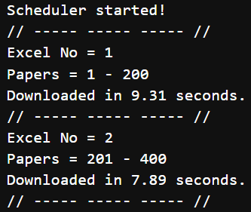

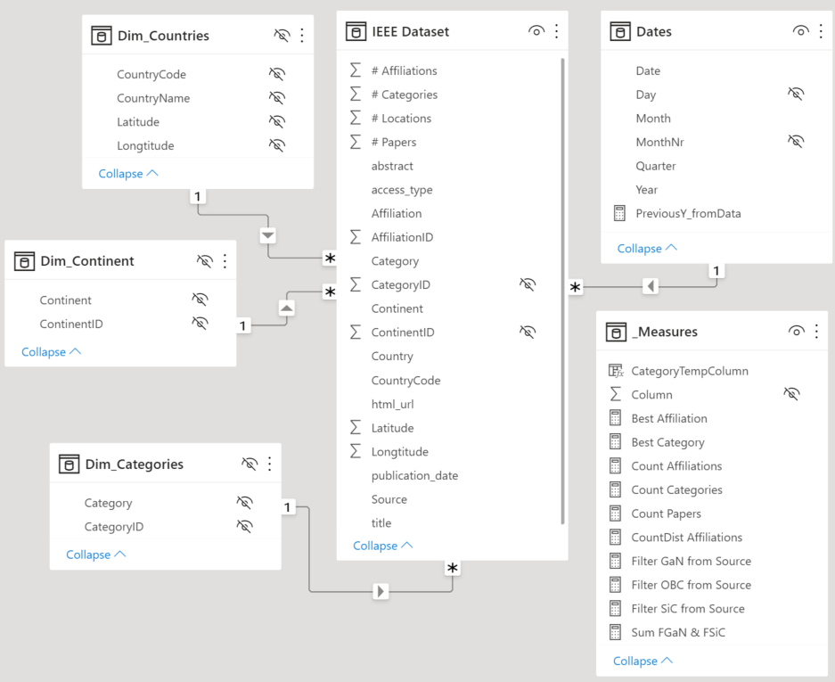
Why & How
Classification 1 - Freq
Classification 2 – ML
Comparison of Methods
Results
1. Research Mapping Classification 2: using Machine Learning
Manual ➔ API
Run script
Limit 1: | 200 Papers / Call
Limit 2: | 40,000 Papers / Day
Average Call Time: | ~8.3s
1. Input:
Clean data
Format data
2. Data Edit:
AUTOMAT ION
Finetuning:
Frequency
Location API
Machine Learning
University
Country
Continent
Max Category Class. Accuracy
3. Location + Affiliation:
➔ 89.6%
➔ 98.9%
➔ 86.7%
➔ 2min49s
% Location Found % Affiliation Found
Machine Learning (Zero-Shot Classification)
4. Classification:
By Frequency ➔
Average Time / 200 Papers:
5. PowerBI:
Established structure model
Visuals available to team
Process needs CEP platform (GPUs)
Method minimizes the manual work needed to function
Metrics: Accuracy & Time
Notes:
Explain API shortly
Data now is dirty, frequency counting cannot work
For location, 3 methods used:
Freq (unusable because of dirty data)
Location API (extreme accuracy ~99% but ~2.5s per call)
ZeroShot (very accurate too, ~0.3s per call w/ GPUs)
Classification with Neural Networks, intelligent?
PowerBI on results only

Slide 7
Why & How
Classification 1 - Freq
Classification 2 – ML
Comparison of Methods
Results
1. Research Mapping Comparison of classification methods
Measure max Acc |  | Class. 1 (Freq) | Class. 2 (ML)
A c c u r a c y * | OBC | 92% | 92%
 | DC/DC Conv. | 66% | 86%
 | Inverter | 48% | 88%
 | GaN | 92% | 96%
 | SiC | 84% | 86%
 | Total | 76.4% | 89.6%
Elapsed Time Yearly (2000 Papers) |  | ~3m26s | 28m10s
Freq Method 1 is ~88% faster than ML Method 2
If strong keywords exist, Freq Method 1 has similar accuracy to ML Method 2 (only 2.2% worse)
Freq Method 1 fails to classify DC/DC Converter & Inverter papers
Monthly ~200 papers
i.e. 2min49s for every 200 papers
*Based on 50 randomly chosen papers, manually categorized
Machine Learning approach chosen
Notes:
Explain how the TestSets were created, the limitation of the tests and the biased personal touch. Also explain the way you mitigate the time cost.

Slide 8
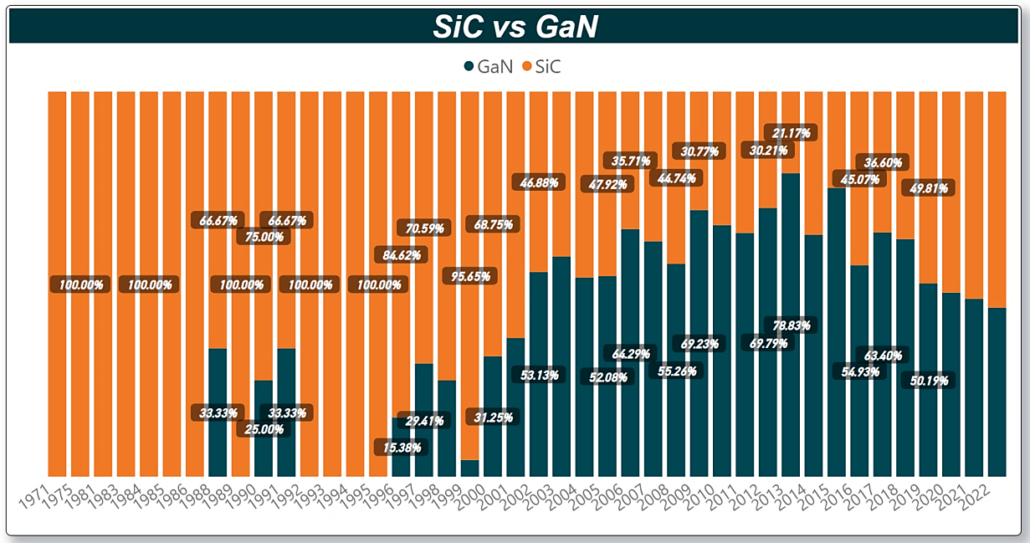
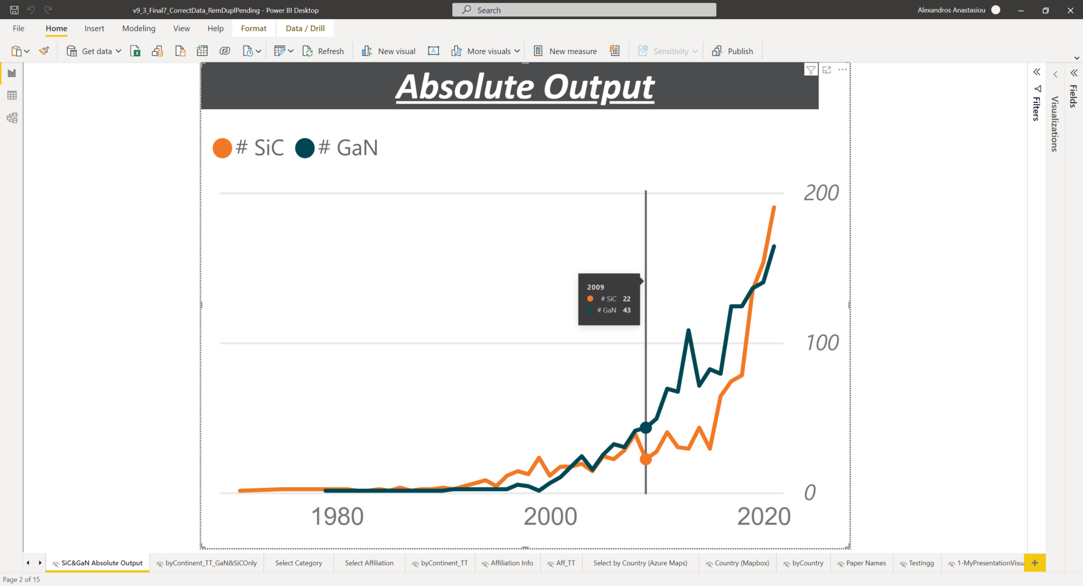
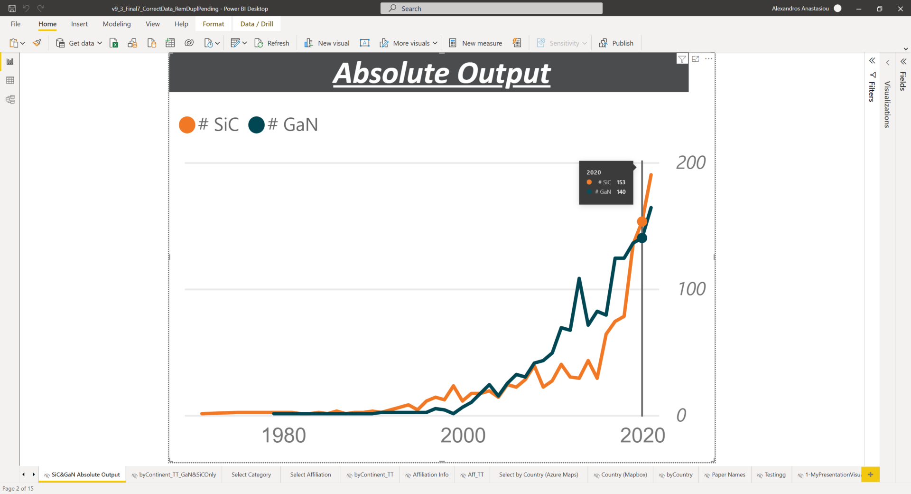
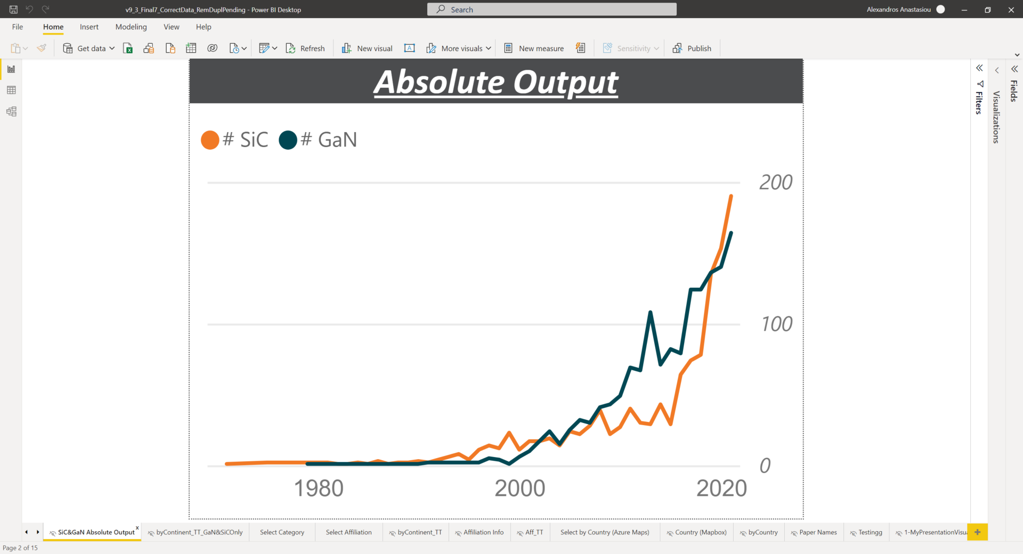


Why & How
Classification 1 - Freq
Classification 2 – ML
Comparison of Methods
Results
1. Research Mapping Results – [ GaN vs SiC ] (1)
2020
#SiC 153
#GaN 140
2009
#SiC 22
#GaN 43
Able to spot Trend:
GaN switch device research picked up from 1996
GaN switch device research surpassed SiC technology starting in 2009
Research output is increasing each year for both categories
Notes:
Compare by:
Trend
Year
Continent
Country in Europe

Slide 9
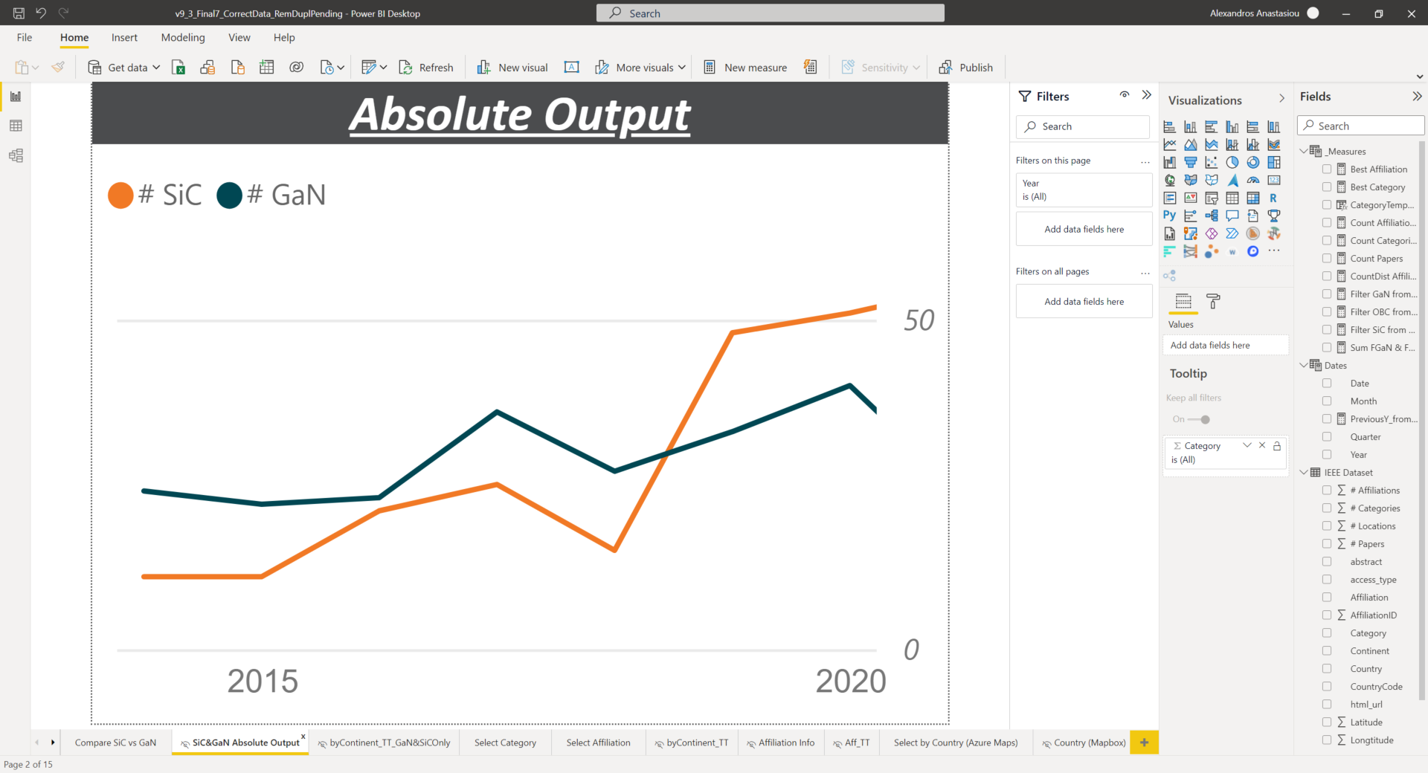
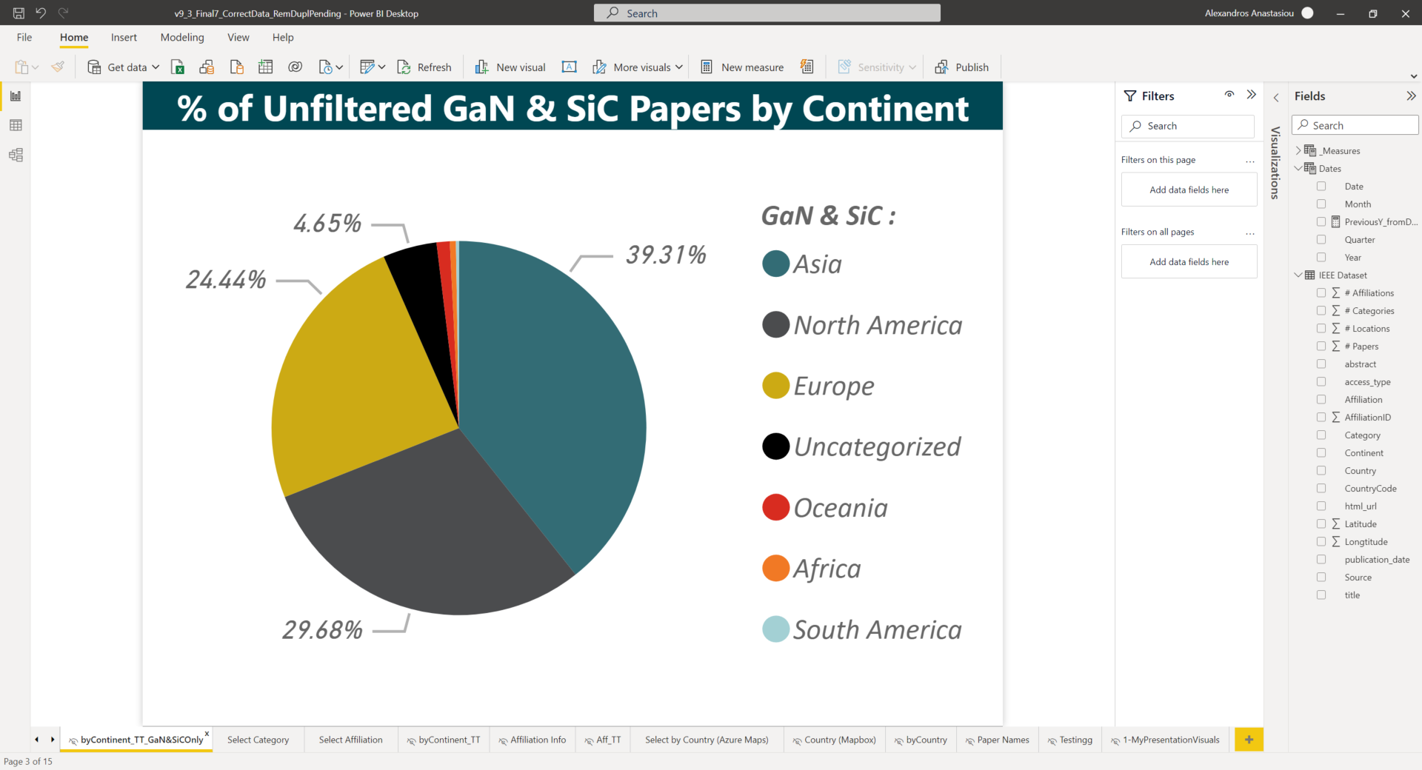
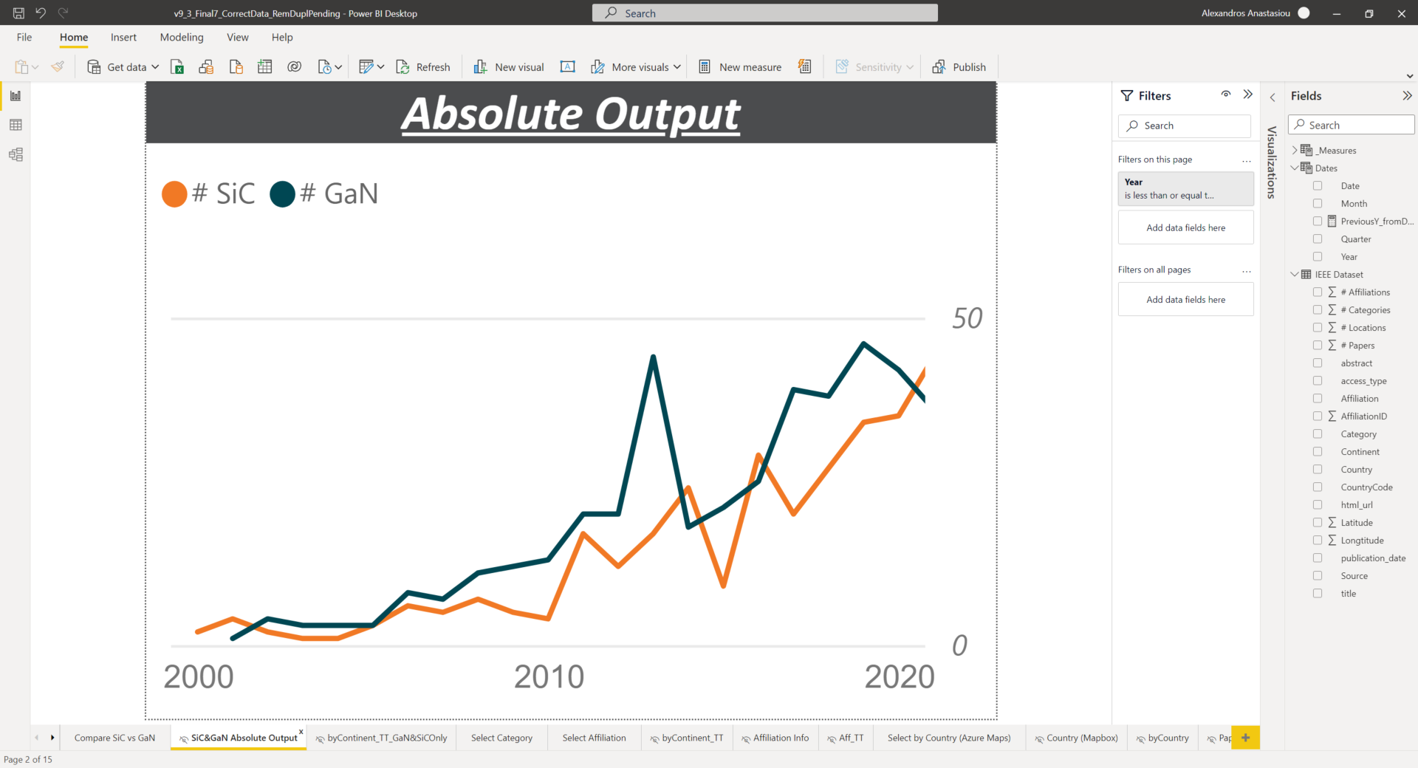
Why & How
Classification 1 - Freq
Classification 2 – ML
Comparison of Methods
Results
1. Research Mapping Results – [ GaN vs SiC ] (2)
Filter : North America
Globally:
North America focuses more on SiC Technology lately
Asia is the largest contributor with 39% of GaN/SiC research.
Filter : Europe
In Europe:
On average, 38 SiC papers / year the past 3Y
On average, 41 GaN papers / year the past 3Y
Europe develops ~24% of GaN & SiC papers (3^{rd.} worldwide)
Europe plays a strong role in global research of GaN technology
Notes:
Compare by:
Trend
Year
Continent
Country in Europe

Slide 10
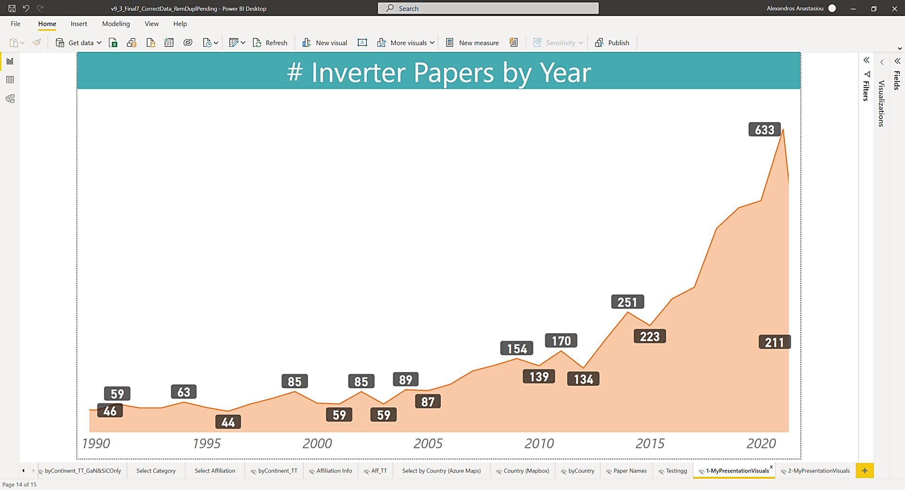
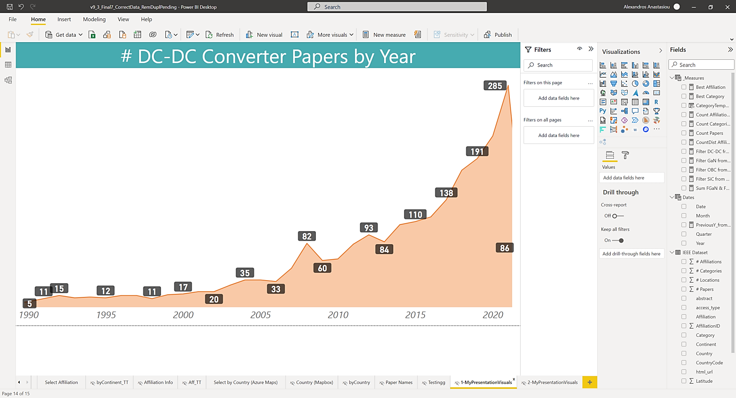
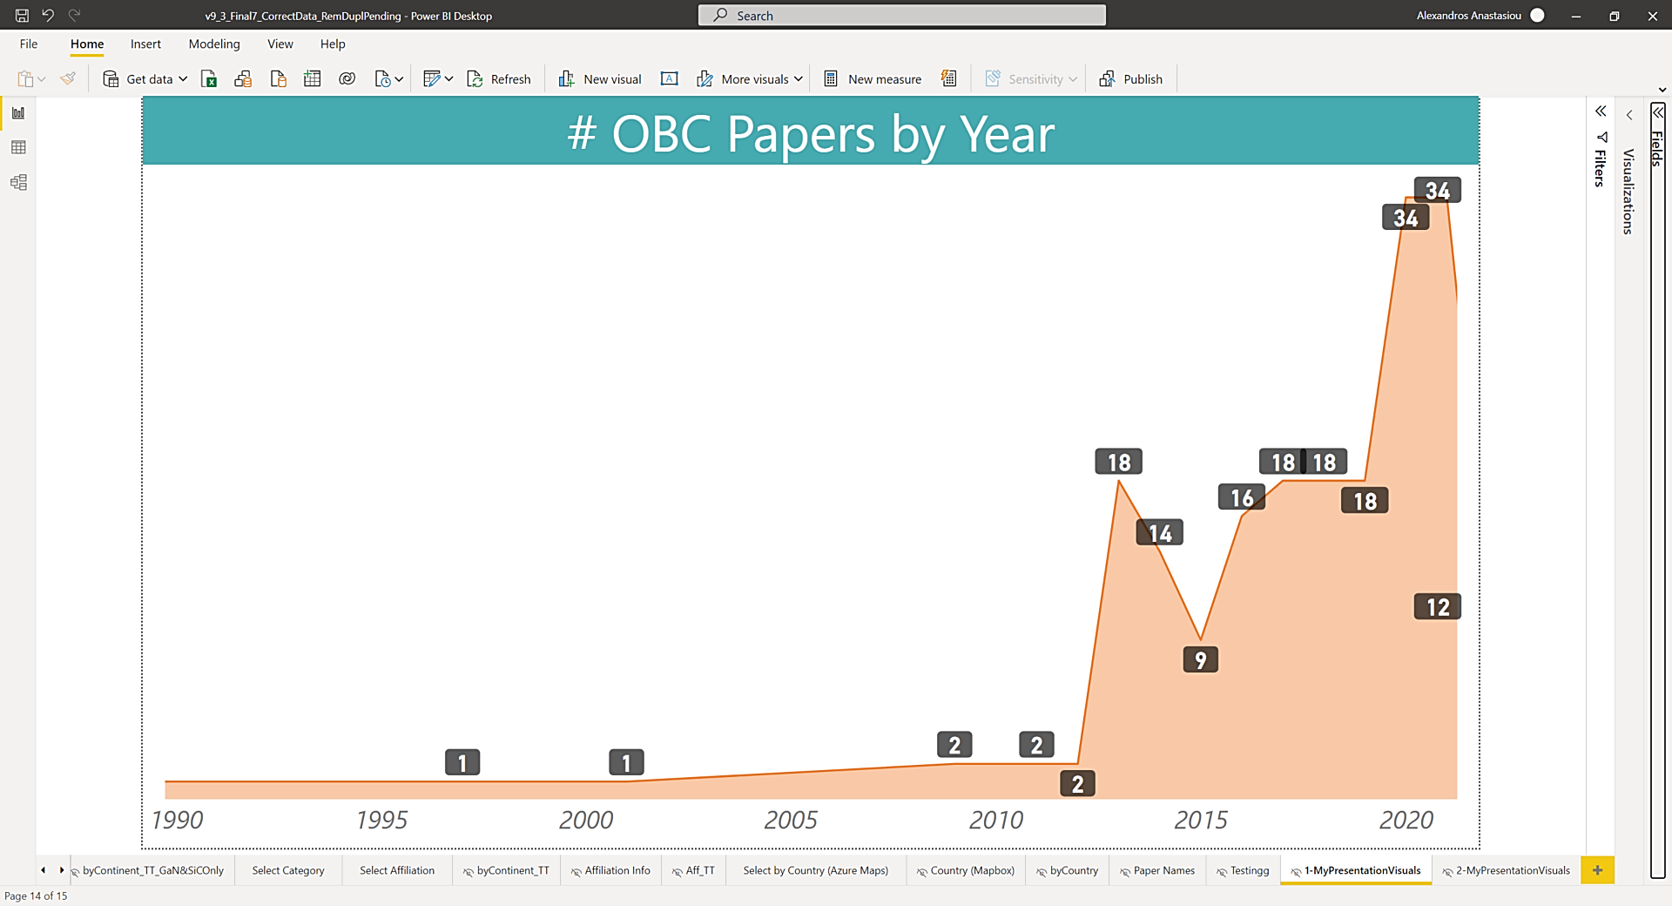
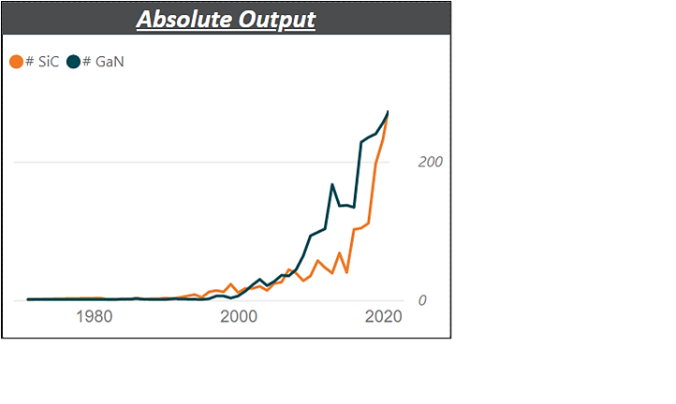
Why & How
Classification 1 - Freq
Classification 2 – ML
Comparison of Methods
Results
1. Research Mapping Results – [# Papers By Year]
Category | # Papers
Onboard Charger | 200
Inverter | 7,024
DC/DC Converter | 2,731
GaN | 1,676
SiC | 1,296
Total ➔ | 12,927
Inverter
DC-DC Converter
OBC research field is relatively new (> 2012) & emerging
Every category output is increasing in later years
*Data denser in later years
Able to see trend by Date*

Slide 11
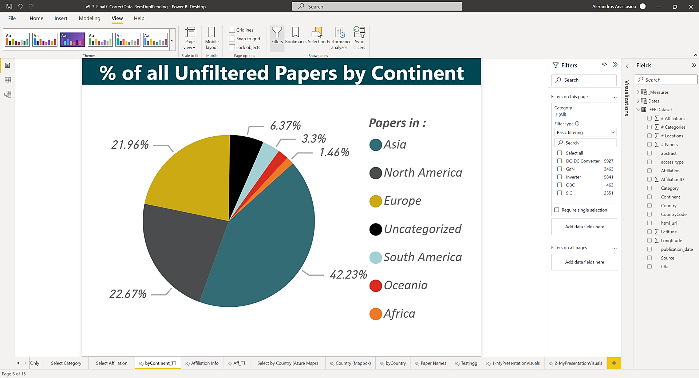
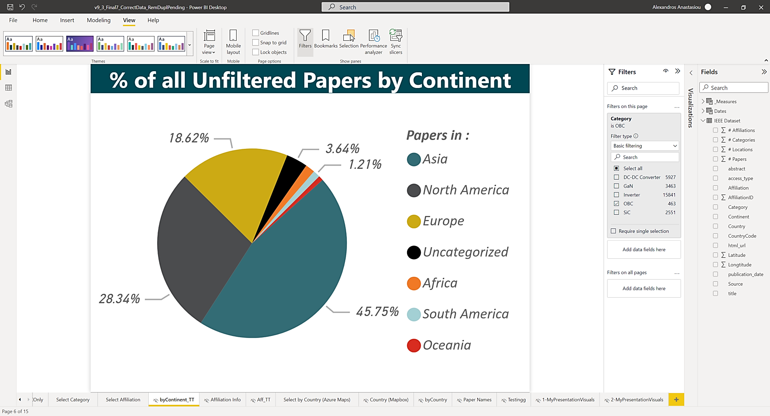
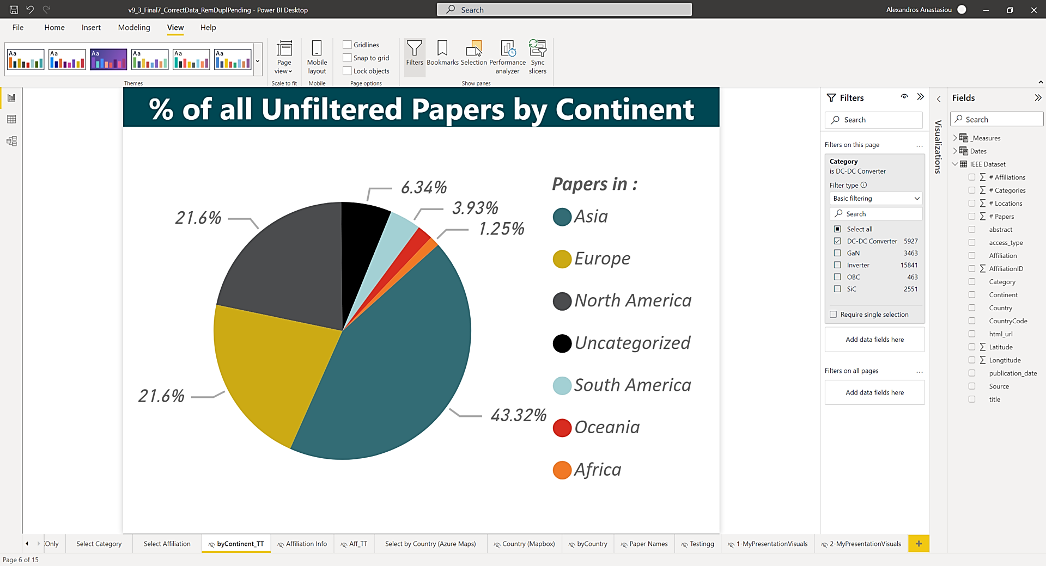
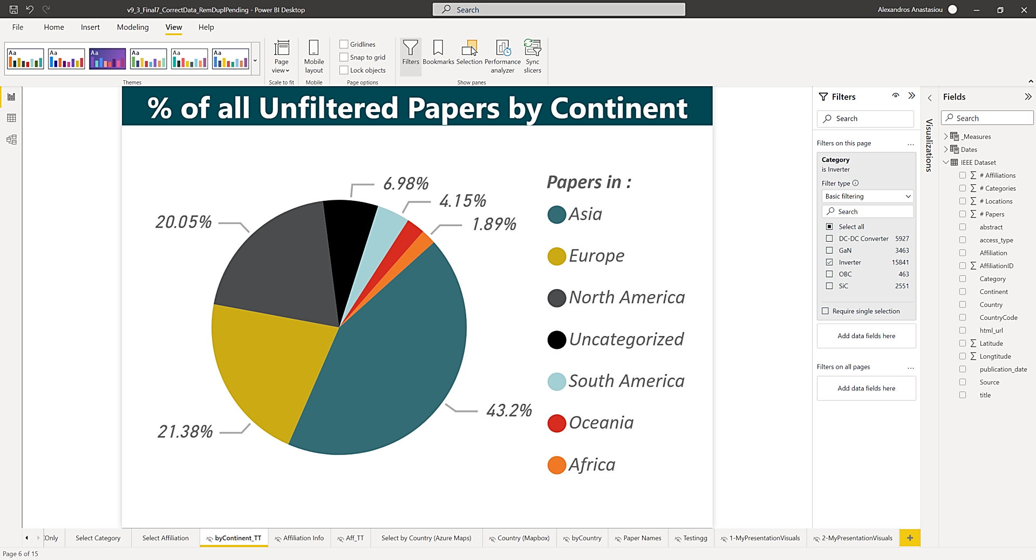
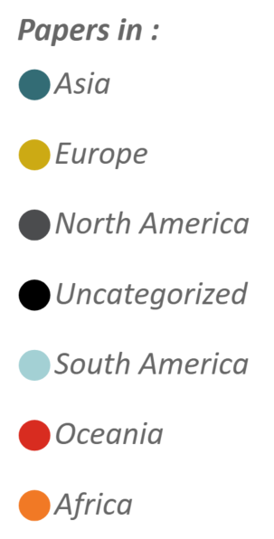
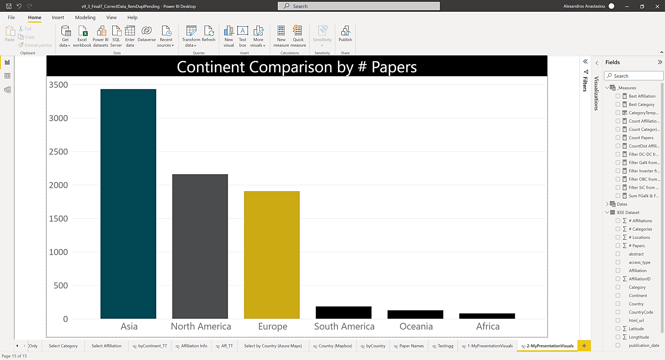
Why & How
Classification 1 - Freq
Classification 2 – ML
Comparison of Methods
Results
1. Research Mapping Results – [# Papers By Location]
All Categories
OBC
DC/DC Converter
Inverter
3432
Consistently, almost 20% of papers come from Europe
715 Affiliations located in Europe (some are counted twice)
EU proves a significant contributor to global research
2160
1907
183
126
79
Can filter by Category, Country, Continent, Affiliation (University, Institute or Laboratory)

Slide 12
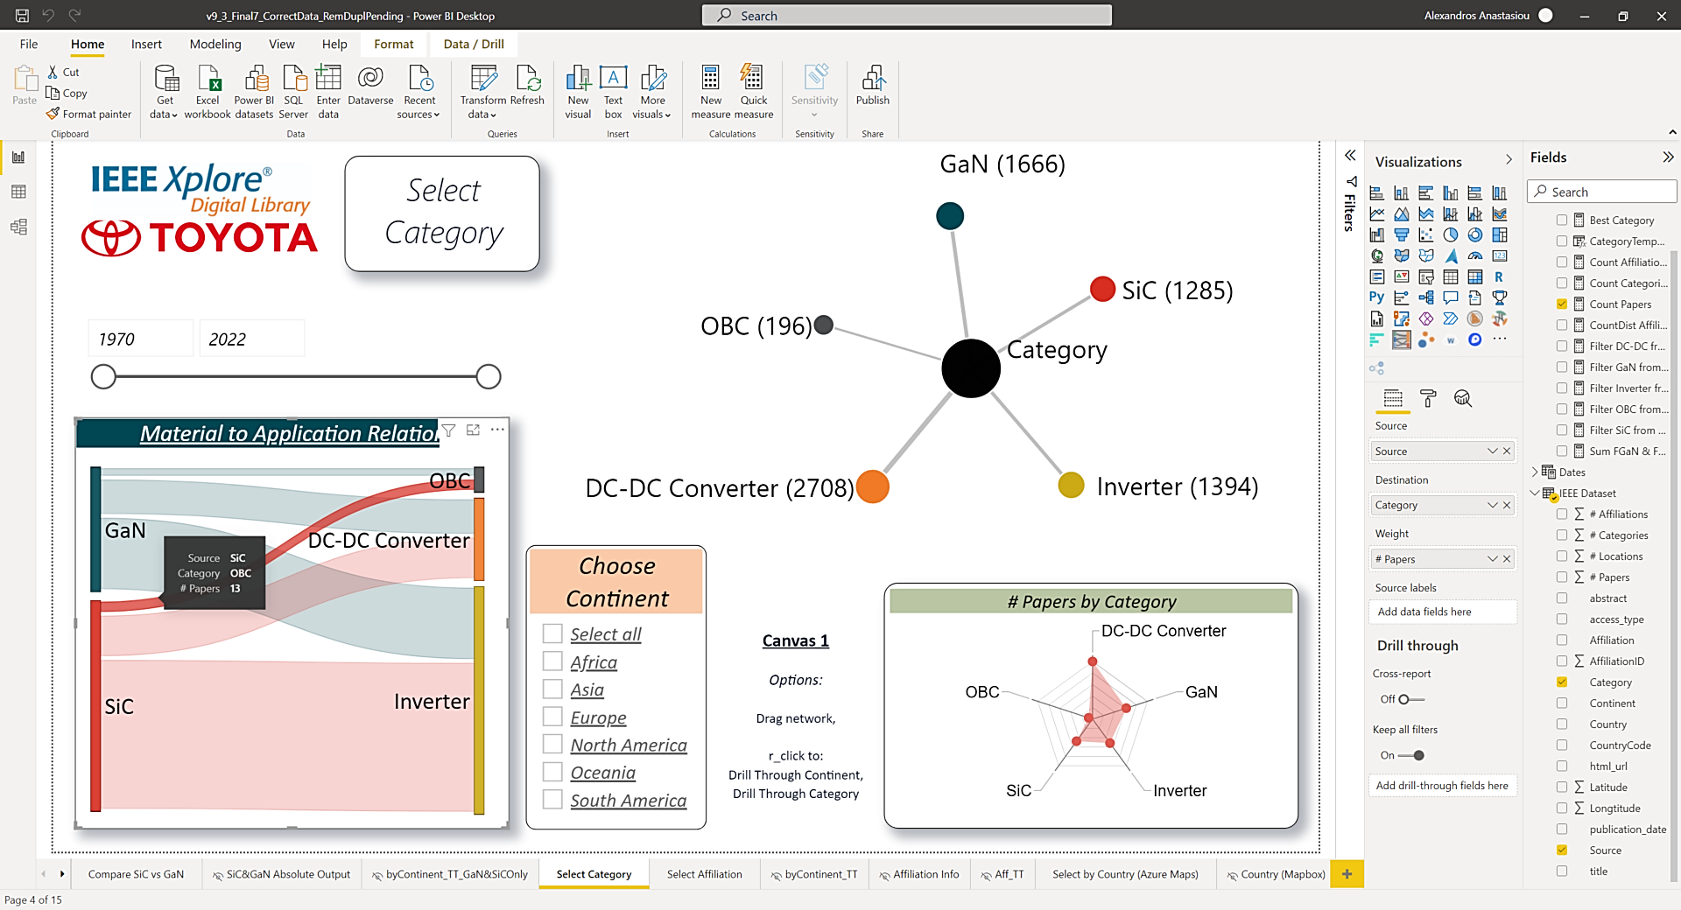
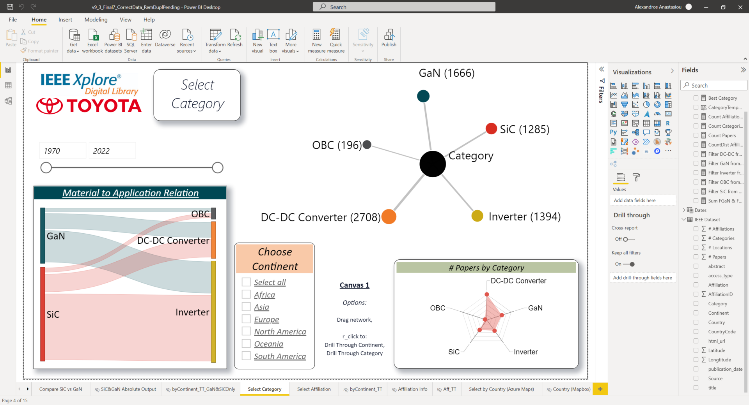
Why & How
Classification 1 - Freq
Classification 2 – ML
Comparison of Methods
Results
1. Research Mapping Results – [Switch Tech ➔ Applications]
Tech: SiC
Appl.: OBC
# Papers: 13
# Papers | SiC | GaN
OBC | 13 | 9
DC/DC Converter | 58 | 49
Inverter | 219 | 104
Total | 290 | 162
Total % | 64% | 36%
Trend: SiC used more than GaN for application purposes (also, more available to the market)
Notes:
Readily available to the market, so it’s expected to have more SiC papers for the applications.

Slide 13
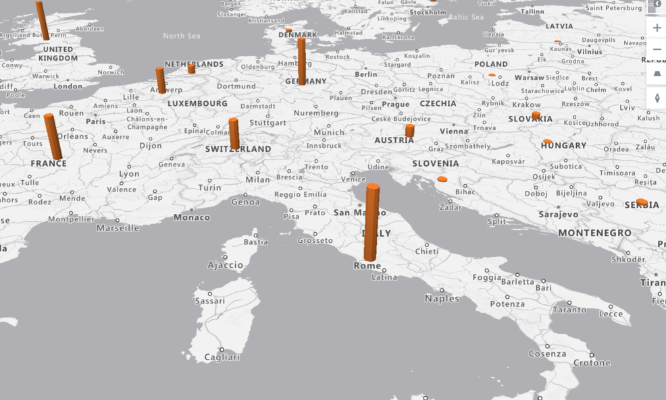
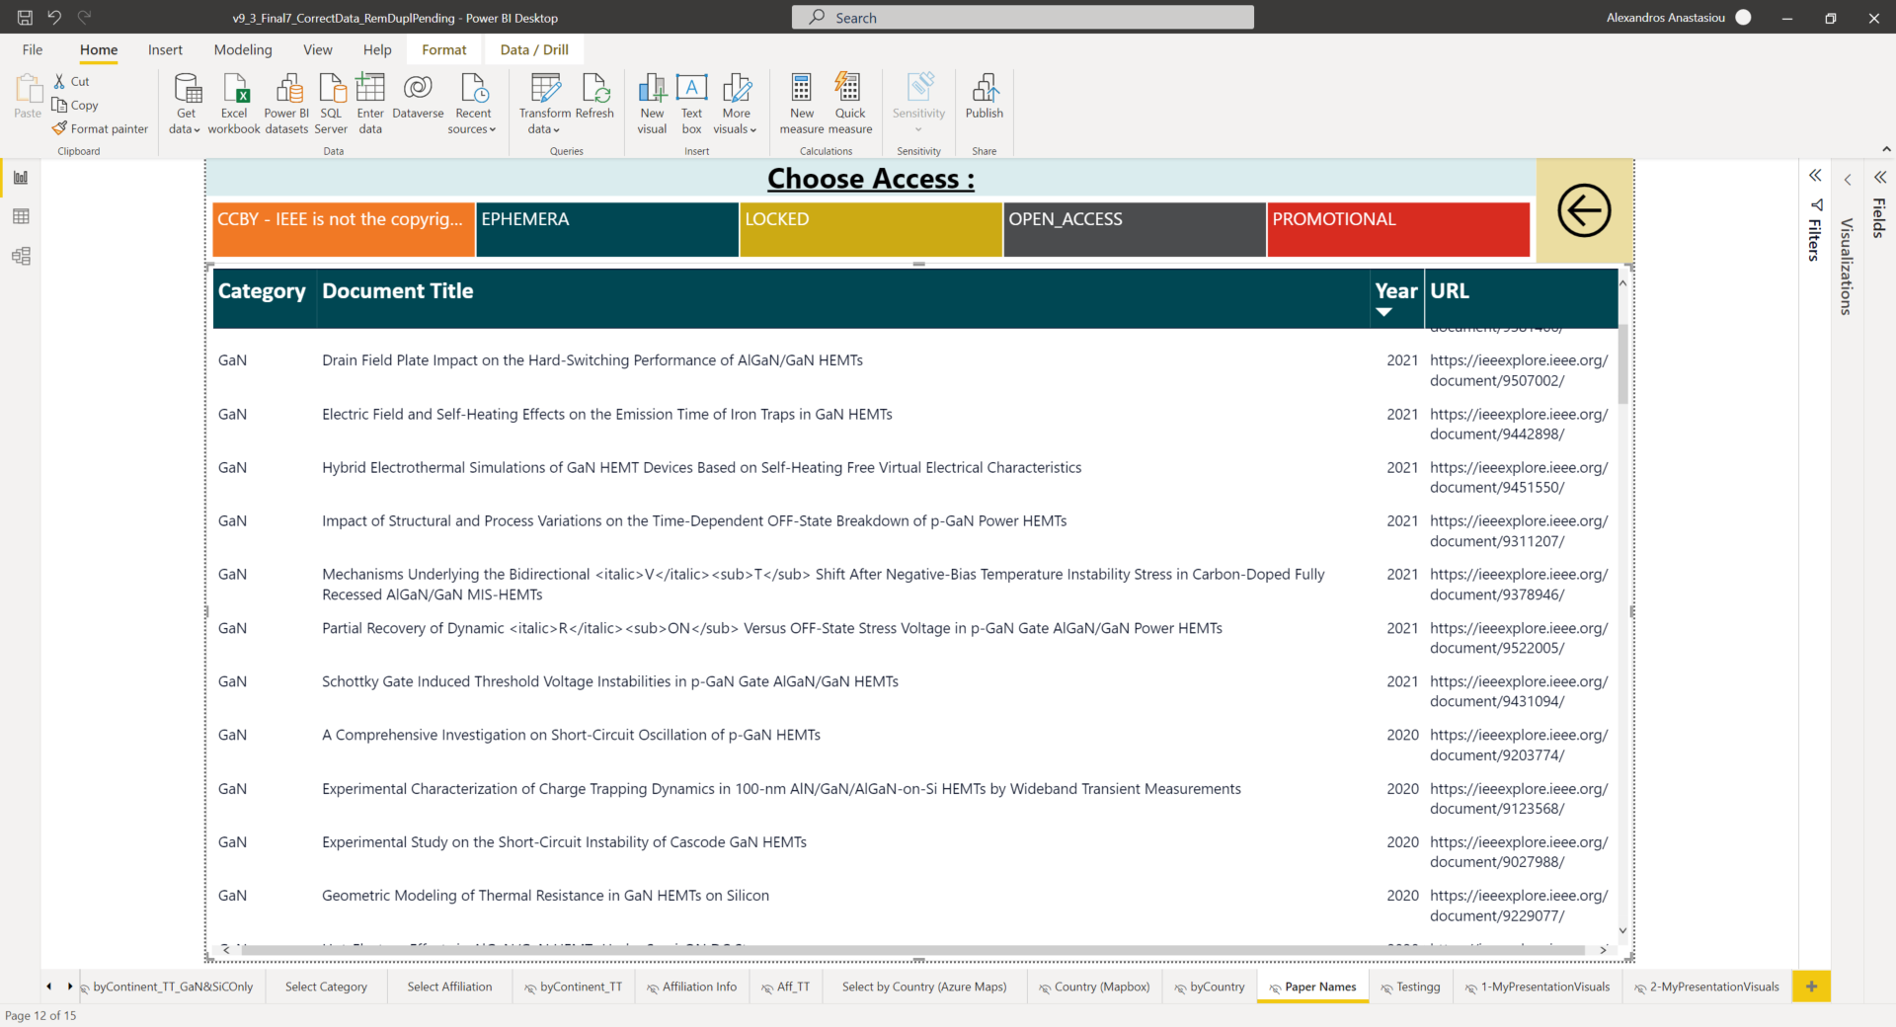
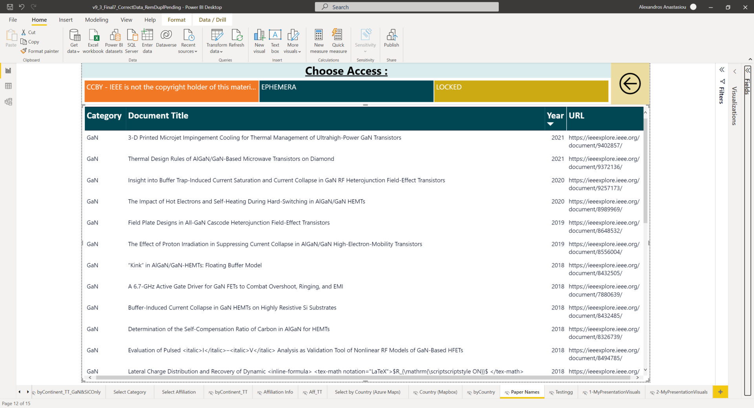
Why & How
Classification 1 - Freq
Classification 2 – ML
Comparison of Methods
Results
Year: all
F I L T E R
1. Research Mapping Results – [Affiliation & Paper Details]
Category: GaN
Affiliation by Continent
Affiliation by Country
[Example]: Top 3 Affiliations for GaN in Europe:
University of Bristol, UK | 41
Chalmers University, UK | 33
University of Padova, Italy | 31
[Example]: Top 3 Affiliations for GaN in Italy:
University of Padova, Italy | 31
University of Bologna, Italy | 12
University of Catania, Italy | 4
Can browse from maps to publication
Notes:
Verbally about aff choice

Slide 14
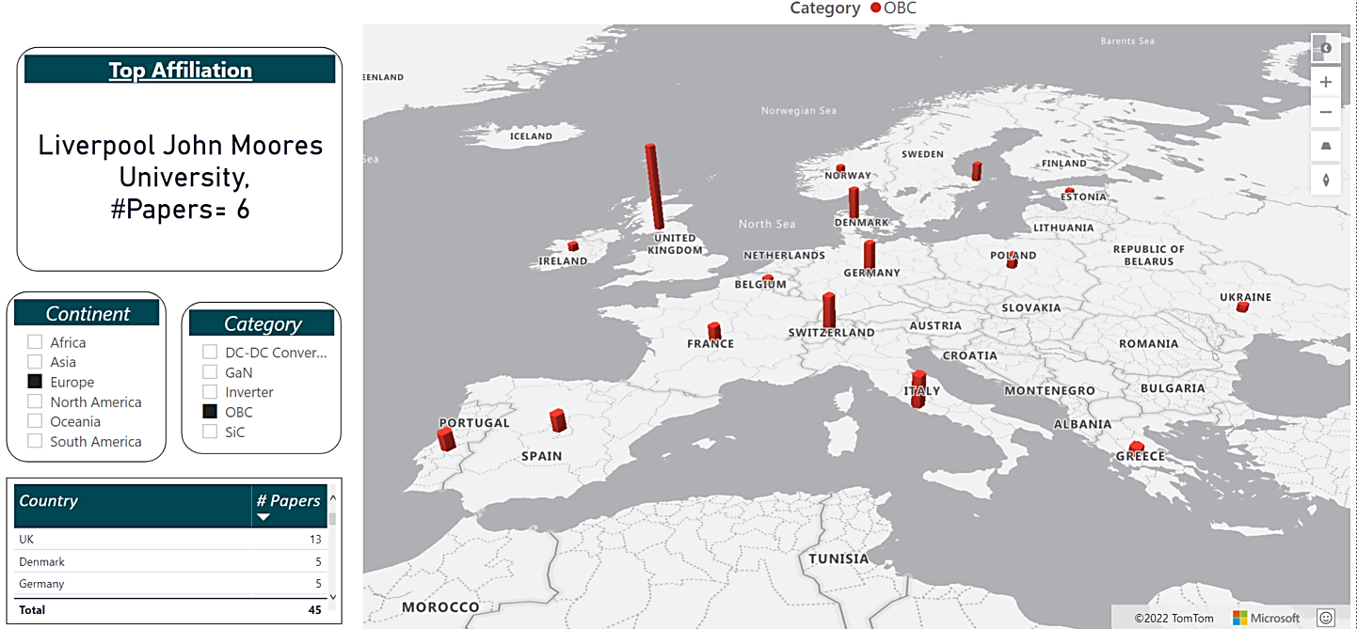
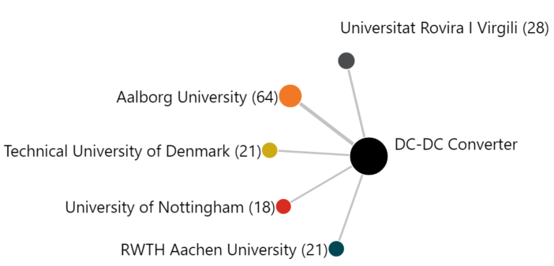
Why & How
Classification 1 - Freq
Classification 2 – ML
Comparison of Methods
Results
1. Research Mapping Results – Map
Category | Affiliation | # Papers
OBC | Liverpool John Moore's Univ., UK | 6
DC/DC Conv. | Aalborg Univ., Denmark | 64
Inverter | Aalborg Univ., Denmark | 30
GaN | Univ. of Bristol, UK | 41
SiC | KTH Royal Inst. of Technology, Sweden | 47
Total | Aalborg Univ., Denmark | 122
Able to visualize Country and Continent Trend
For a certain category, able to choose proper affiliation

Slide 15
Next Steps
Location in Database must be matched more accurately
Power BI mapping can be customized to better fit team needs
More Category Fields can be implemented
Fuzzy logic to match similar affiliations
Find / Create database with all Affiliations to correct the IEEE ones
Finetuning through feedback from internal team use
Categories of interest are Electromagnetic Interference, Thermal Management etc.

Slide 16
Comments After Presentation
Can this work be expanded to more fields?
How to assess, not quantity, but quality of Papers?
YES:
Need to add search terms in IEEE API
Then need to make a copy of the training files and finetune it for the respective field
Then PowerBI needs to include this extra category
BUT:
The challenge lies in the classification : certain keywords are easy (GaN) but others, less specialized, are not (ie. Controls), so the question needs to be as precise as possible.
Very difficult to make ML algorithm understand the quality of the paper. That would mean the model “understands” semantic info, which is not the case. But certain metrics may exist which can be used, not dependent from the ML algorithm (Victor).

Slide 17
Topologies:
Onboard Charger
DC/DC Converter
Inverter
Extras
2. Topologies Mapping
Reviewed:
9 Conferences
6 Suppliers (mtg)
Onboard Charger (OBC):
Trends spotted:
Topology Count | Using E-Motor winding | PFC | DC-DC Converter | Switch Type | Efficiency | Power density
2 x | YES | Full Wave PFC | Motor+Inverter | Si | 93% | -
5 x | NO | 3-Phase Totem Pole | Double Active Bridge | SiC(x4), GaN | 95% (SiC), 97% (GaN) | -
6 x | NO | 3-Phase Totem Pole | LLC Resonant | SiC (x5), GaN | 95.7% (SiC), 97% (GaN | 1.4kW/l (SiC), 2.47kW/l(GaN)
1 x | NO | 1-Phase Totem Pole | Isolated DC/DC | GaN | 97.5 | -
PFC: 3ph Totem Pole
GaN switch technology
GaN switch technology
GaN switch technology
Improves efficiency
Superior than SiC
Improves Density
Not yet the trend
Goal: Understand most common topologies and their benefits
For Onboard Charger most common topology is 3-ph Totem Pole PFC with LLC Resonant DC/DC Converter
Notes:
“Please allow me to quickly present my two other, secondary tasks. They played a huge role for my understanding and judging of the categories we have mapped already. The first one is, Topologies mapping :”
PCIM ’20 Inovance
PCIM ’21 Hella
SIA 21 Meta system
CPE ’21 Infineon
EEHE ’21 KOSTAL
E-Motive ’21 Vitesco
ECCE ’21
IWIPP ’21
PowerEng ‘21

Slide 18
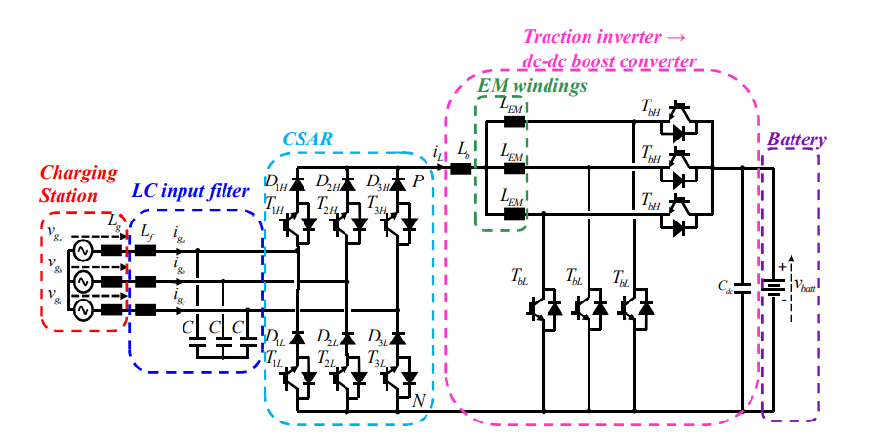
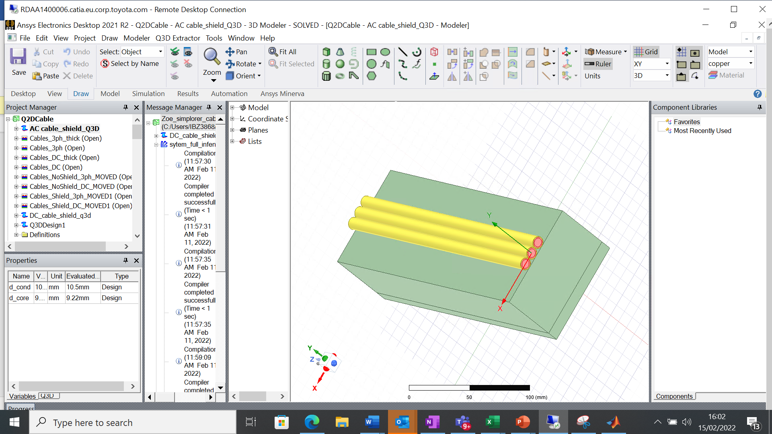
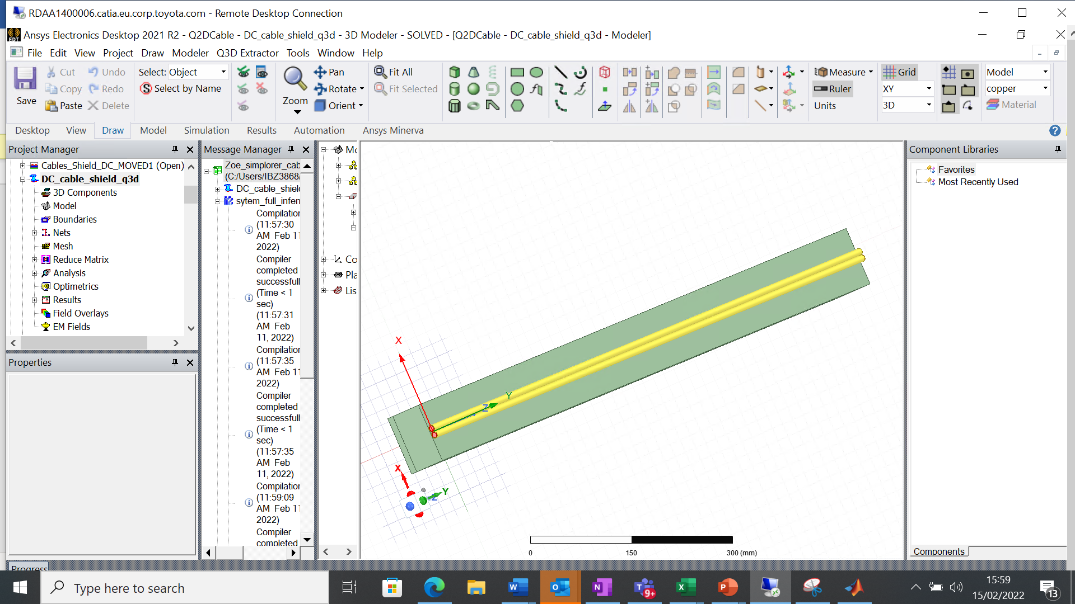
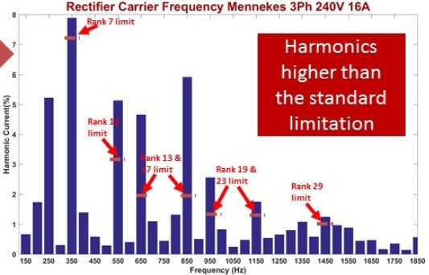
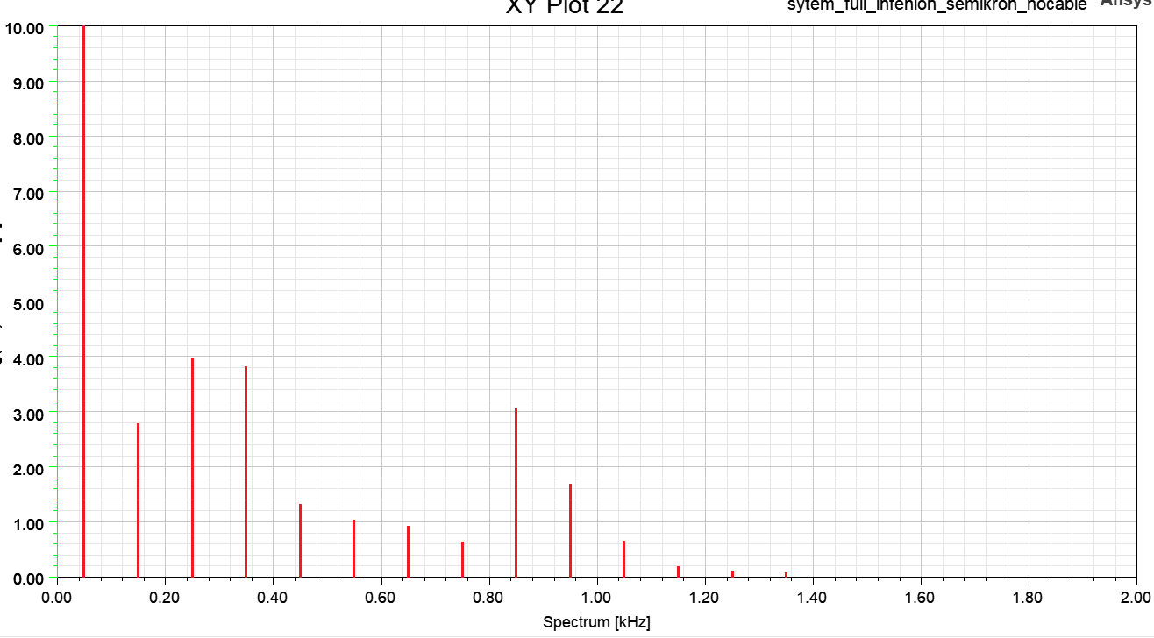
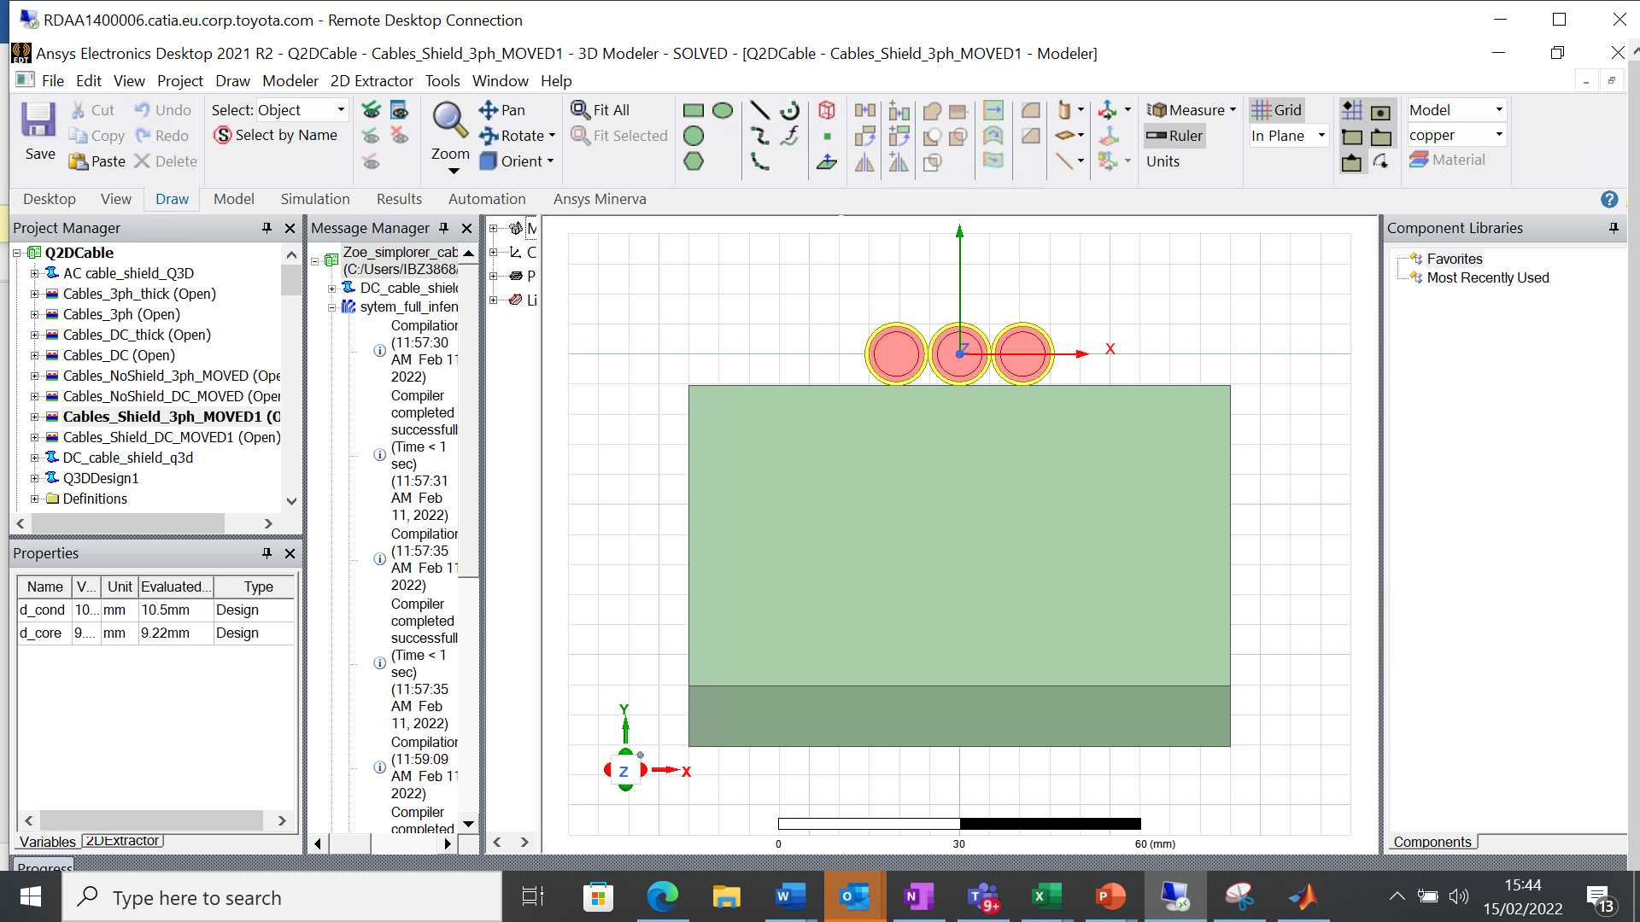
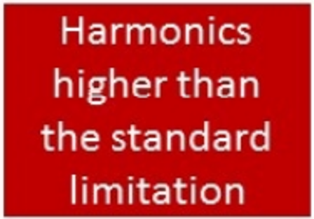
3. Supporting Activities Cable equivalent impedance model (Integrated Charger)
Zoe Onboard Charger Topology
Need for simulation model (Ansys)
Converge Simulation to Measurements
Cable Implementation
Motor Cables
Battery Cables
Problem:
Simulated vs Measured harmonics not matching
Harmonics at 11kW :
Motor cable
Battery cable
Measured harmonics
Simulated harmonics without filter
Motor cable
Shield
Ground
Conclusion: Modeling of cables has no effect on conducted noise in frequency range of interest
Notes:
KEEP TO 1 MINUTE ONLY
Flow:
Show parts of Zoe Topology
Problem with Harmonics -> Which parts were simulated until then ?
Among possible causes, Cables were one of them, that’s why we simulated it in Ansys Software
Two parts, Motor (3ph) and Battery (2ph) with real numbers from database
Modelling with shields outside the cables and common ground but still no heavy influence in Harmonics.
What is it then?
Static vs Dynamic IGBT model
-> Filter <-
“Repeating with Cables had Zero Effect”
Exactly the same results
Battery -> Only resistance
No filter
Measurements in TME 2018
Limits of Standard -> IEC 61000-3-2
Cables: Low Freq -> 2kHz & Resonance is ~7MHz (out of scope)
Static to Dynamic IGBTs -> scale to MHz
Battery, from Resistance -> to SoC, Cells
At the beginning, Study topology on info already there.
Filter not used so normal that we exceed limits
Which part of the four (cables, igbt, battery, filter)

Slide 19
Thank you

